Slide 1
DAEmod-915 Transceiver
Distributed Amateur EFR32FG23 module for 915MHz
Team: Peter Handler, Philip Pierce, and Connor Dickey
Advisors: Dr. Aleksander Malinowski and Dr. Prasad Shastry
Department of Electrical and Computer Engineering, Bradley University
Notes:
I’m Connor Dickey and we’re all senior electrical engineering students presenting our project on a 915 MHz Transceiver System for Digital Communication called DAEmod-915. This stands for Distrubuted Amatuer EFR32 module for 915 MHz.

Slide 2
Presentation Outline
Overview
Goals
Specifications
Progression
Funding
Future Work
Notes:
Project Outline

Slide 3
Overview
Notes:
With that, I will layout the background and scope of the project

Slide 4


Project Statement
Within the market, there is a lack of 915MHz open-source and open-hardware modules for implementing digital radio modes in the 915 MHz ISM band.
Create a highly configurable platform to make a positive impact in open initiatives and receive contributions from others.
Select low cost and ubiquitous hardware to facilitate inexpensive modules.
Notes:
Our Project came about due to ….
Our goal is to…..
We planned to accomplish that though ….

Slide 5
Table of LoRa WAN vs our Product
 | LoRa | Our Product
Frequency | 902-928 MHz | 902-928 MHz
Data Rate | 300 bit/s - 27 kbit/s | 512 bit/s - 2 Mbit/s
Duty Cycle | Very Low | Up to 100%
Hand-Shake | Required Handshake | Optional Handshake
Broadcasting | Does not Support | Support
License | $6000 Yearly | GPLv3
Notes:
In the US, the 915MHz band is one of the Industrial, Scientific, and Medical bands that covers a frequency range of 902–928 MHz.
DAEMod-915 has one major competitor on the band, LoRa. While LoRa is a proprietary standard needing a costly license to design and implement, DAEMod-915 will be open to the public to use, develop, and implement to their given needs. DAEMod-915 also is intended for higher duty-cycle applications such as images compared to LoRa.
In the table, we compare our goal product against LoRa.

Slide 6
Device Specifications

Slide 7
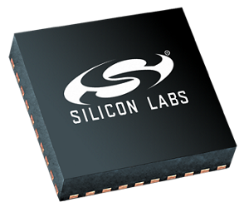
Final Specifications of Transceiver module
Transceiver | EFR32FG23
Wide Operating Range | 1.71 V to 3.8 V -40 °C to +125 °C
Antenna | SMA male 50 Ω
Power Max | 13 dBm - 20mW
Frequencies | 915 ISM band (902-928 MHz)
Theoretical Range
2dbi Antenna ideal range is 2.9km (1.80 Miles)
5dbi Antenna ideal range is 15km (9.3 Miles)
Baseline Current draw at 3.3V
Sleep draw is 26 μA
Full TX draw is 85.5mA
RX draw is 4mA
Notes:
-40 c to 125c
this frequency range strikes a good balance between cost, range, and available spectrum

Slide 8
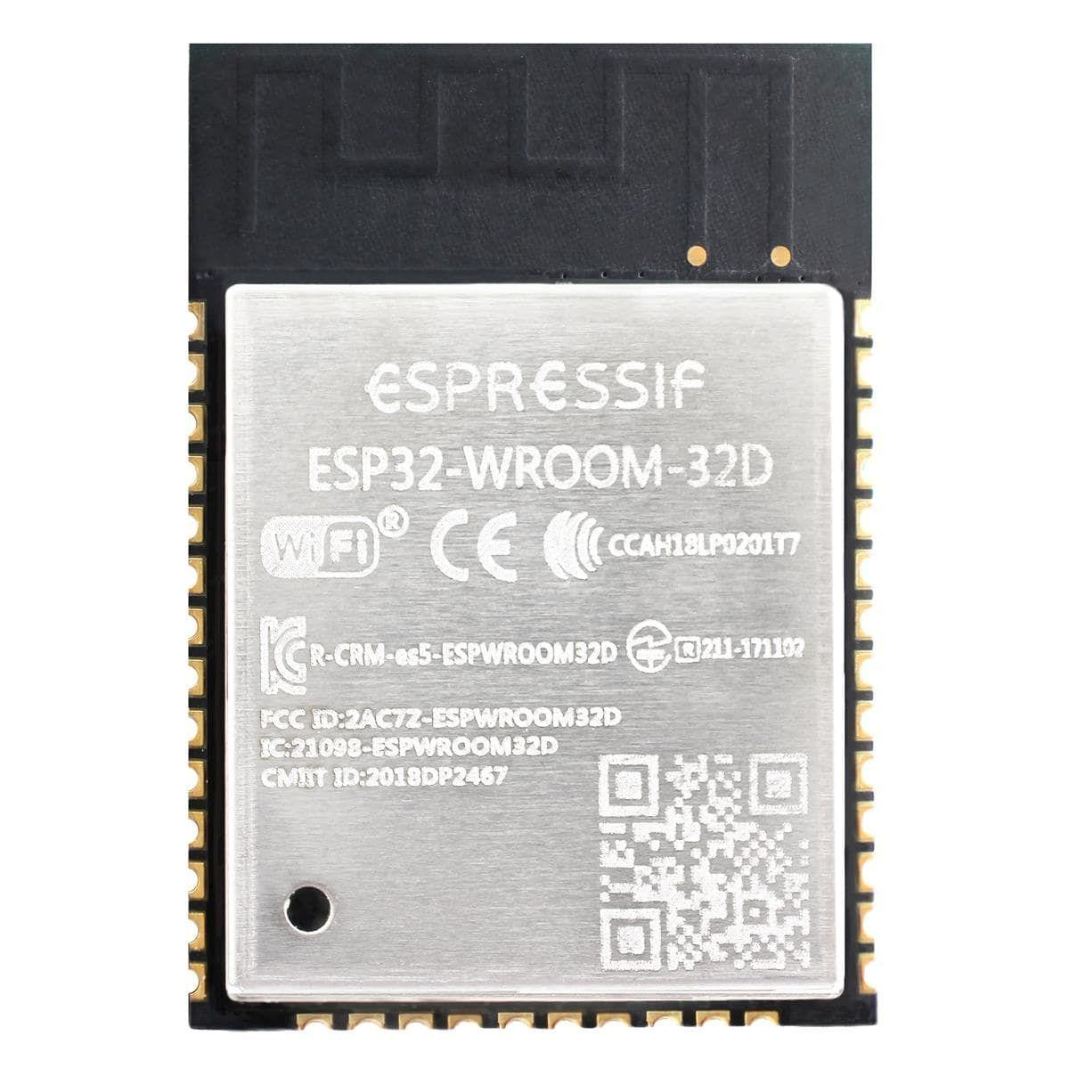
Final Specifications of Control module
Microcontroller | ESP 32
Communication I/O Protocols | SPI, I2C, WiFi, BT UART
Power Supply | 6V → 5V → 3.3V
Testes Modules | Camera, Display, GPS, Battery, and Environment Sensor
Baseline Current draw 3.3V
Sleep draw is .8mA
RF Tx off draw is 40mA
RF Tx on draw is 160mA
RF Tx off, Wifi/BT on draw 240mA
External power budget 6V
1A peak draw to peripheral devices
Notes:
-40,105

Slide 9
Block Diagram

Slide 10
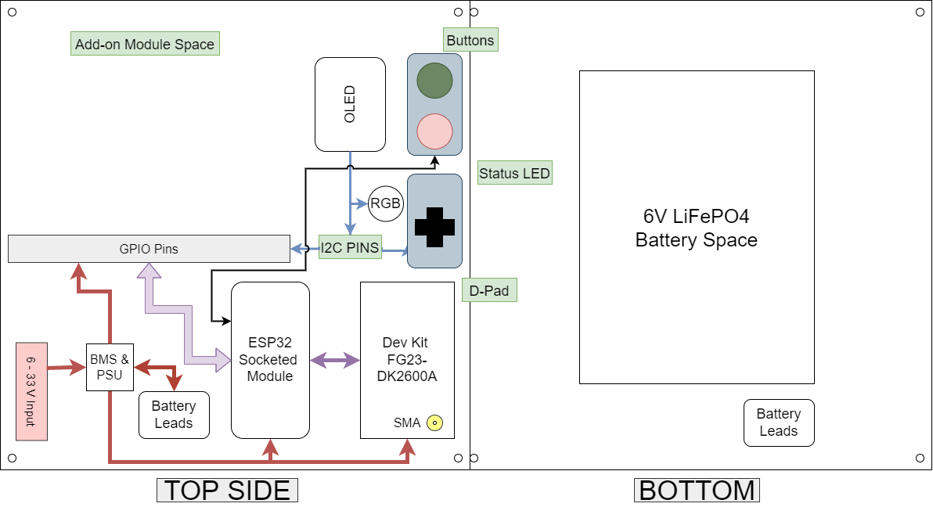
Notes:
The Block Diagram details the connection between all the major modules that make up the DAEMod-915 Platform. Our central module is the ESP-32 microcontroller allows a variety of modules to connect using industry standard protocols, such as SPI, I²C, and UART. Our RF IC is the Silicon Labs EFR32 which is on the FG23 DevKit. This dev kit does the transmitting between to other DAEMod-915 devices. On the bottom side, there is space for a 6V LiFePO4 battery pack to allow for portable/remote use cases.

Slide 11
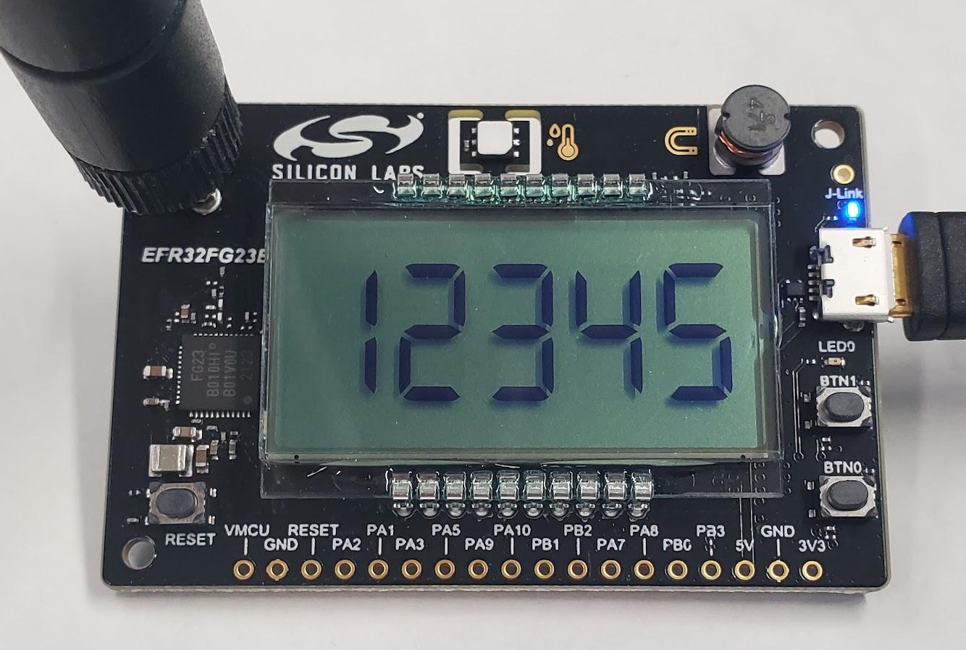
Transceiver module (Dev Kit FG23-DK2600A)
Silicon Labs IC in dev kit will be used for the final custom PCB implementation EFR32FG23A010f256GM48
Low cost, new, and readily available at $40
Development environment in Simplicity Studio with detailed API documentation
Selectable modulation schemes including: FSK, ASK, GFSK, AFSK, GMSK, OOK, OQPSK-DSSS
Notes:
Why we chose

Slide 12
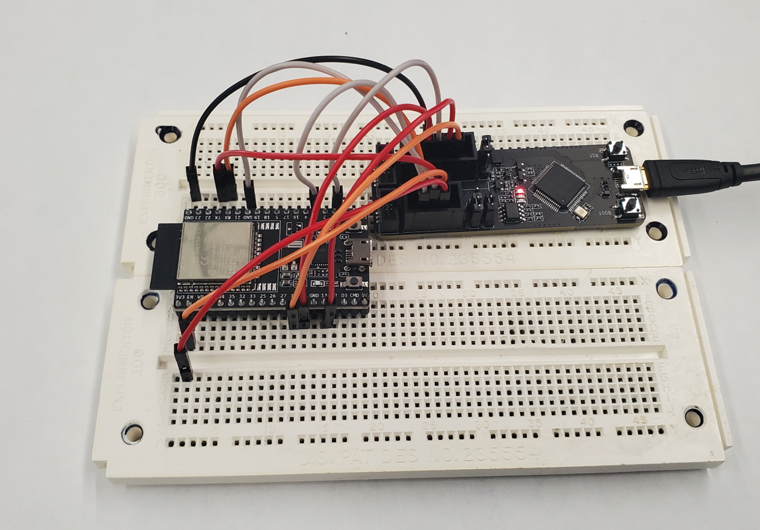
ESP32 module
Listen on local WiFi server with options to send and print received data.
Xtensa dual-core 32-bit LX6 microprocessor, up to 240 MHz, 4MB SPI Flash
Development environment in VSCode using PlatformIO and Espressif 32.
ESP-PROG for live debugging.
Creating set of control signals over UART using a form of the ESP AT Command Set.
Notes:
Why we chose

Slide 13
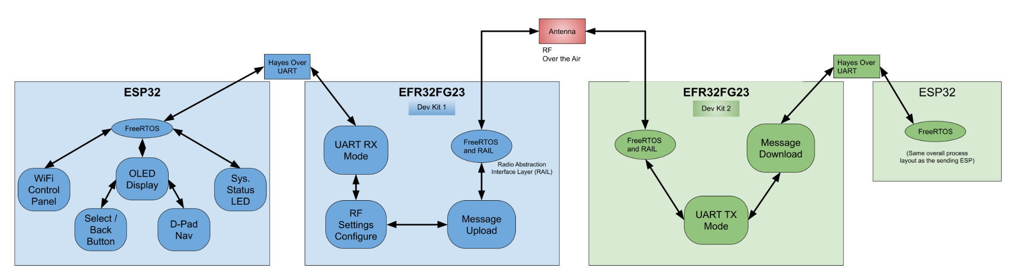
Software Design
Notes:
The prototype software layout is pictured here. Effectively, we have two separate systems with the same hardware running FreeRTOS. On the transmitter side, the ESP32 takes input from a variety of interfaces to decide what and when to send. The ESP board via UART sends/receives AT commands/responses through UART on the EFR32. The EFR would send the RF over the air and the same process happens in reverse.

Slide 14
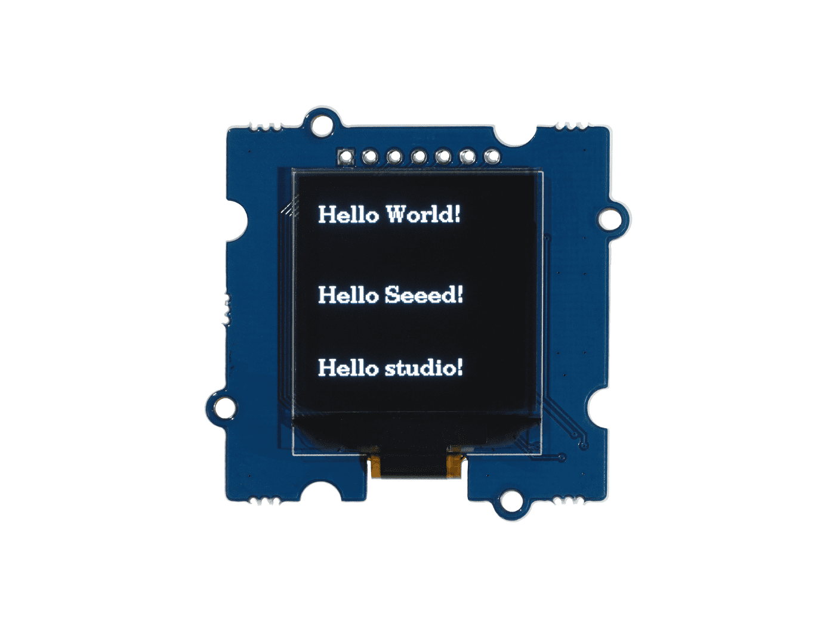
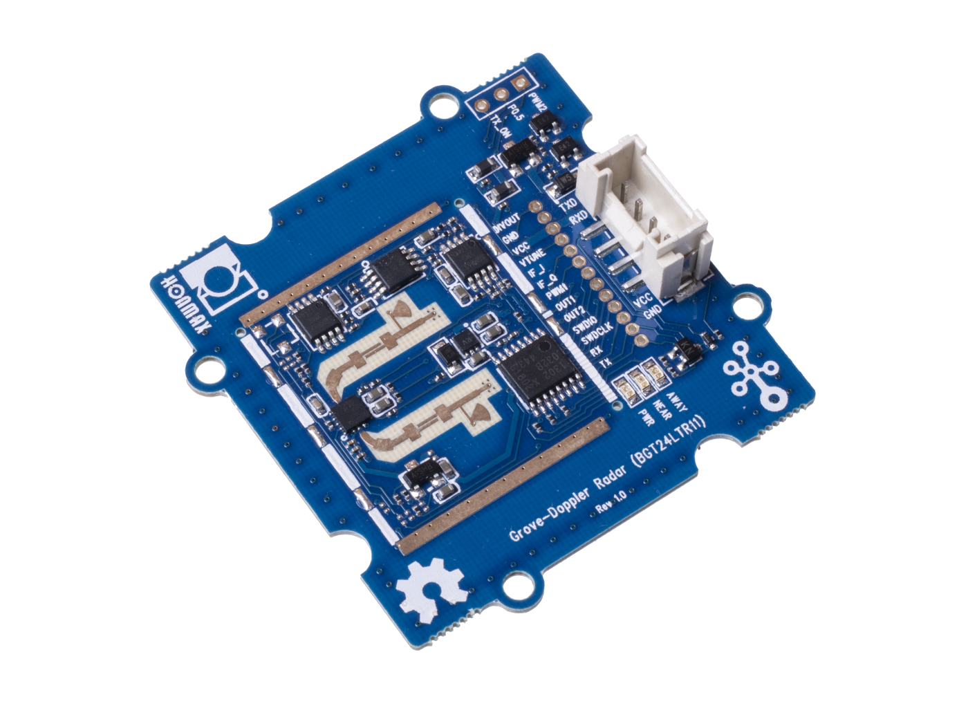
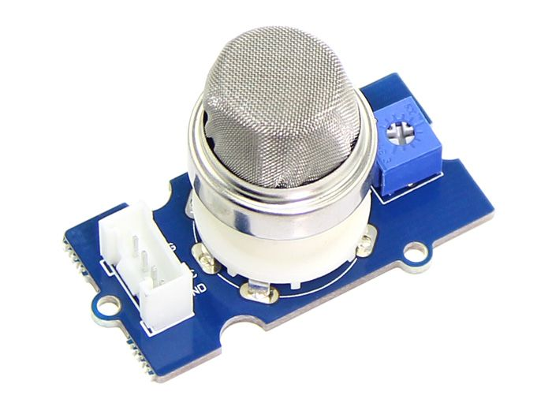
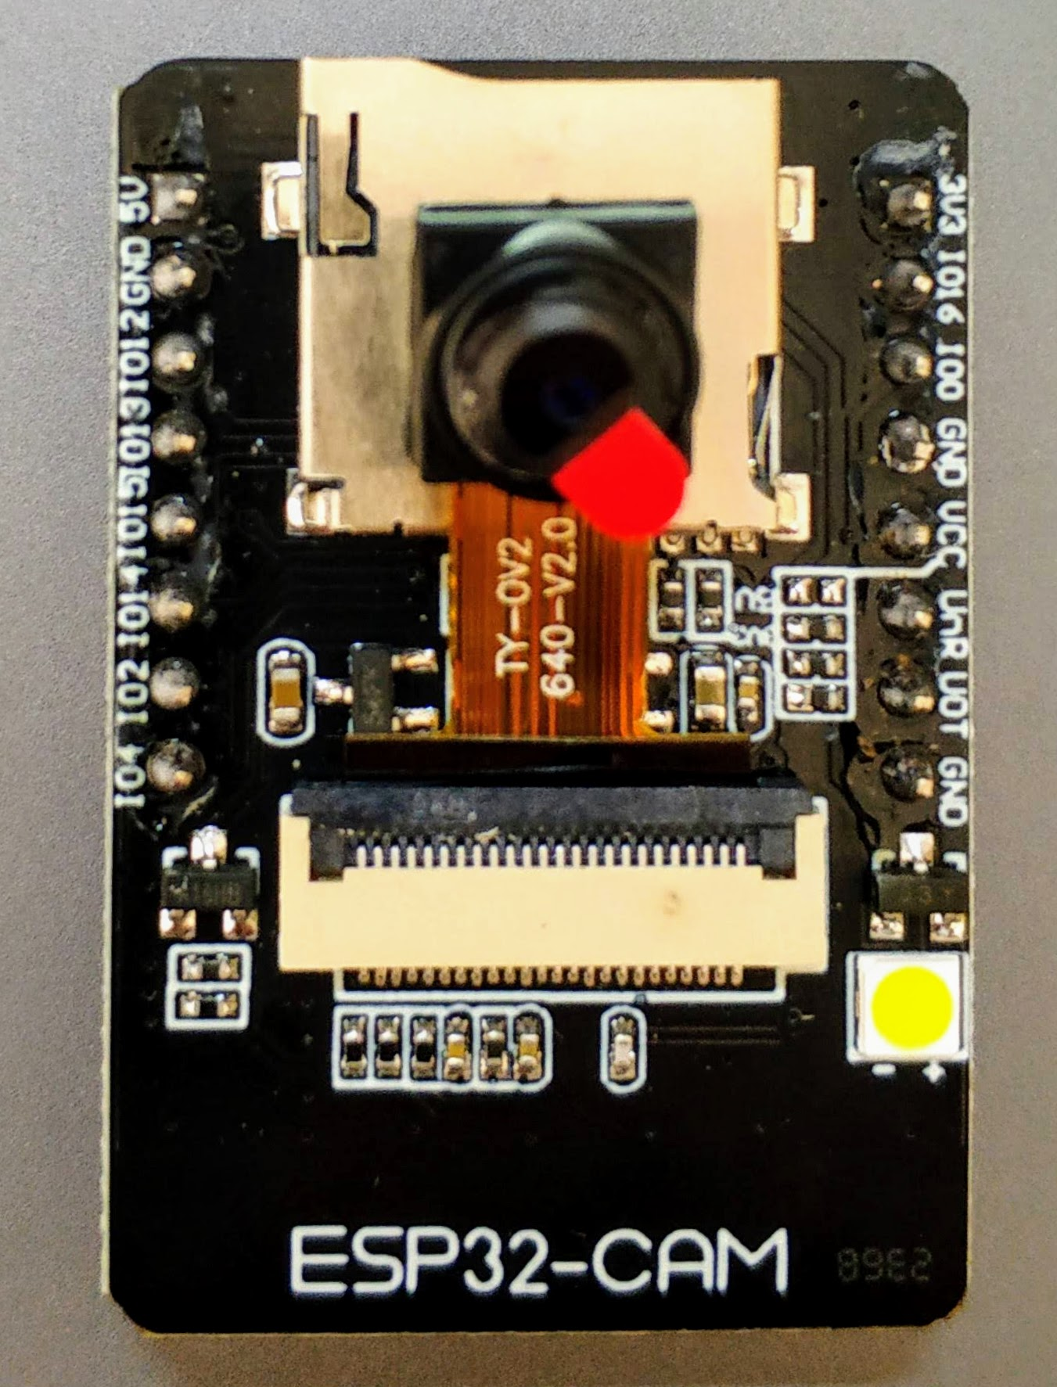
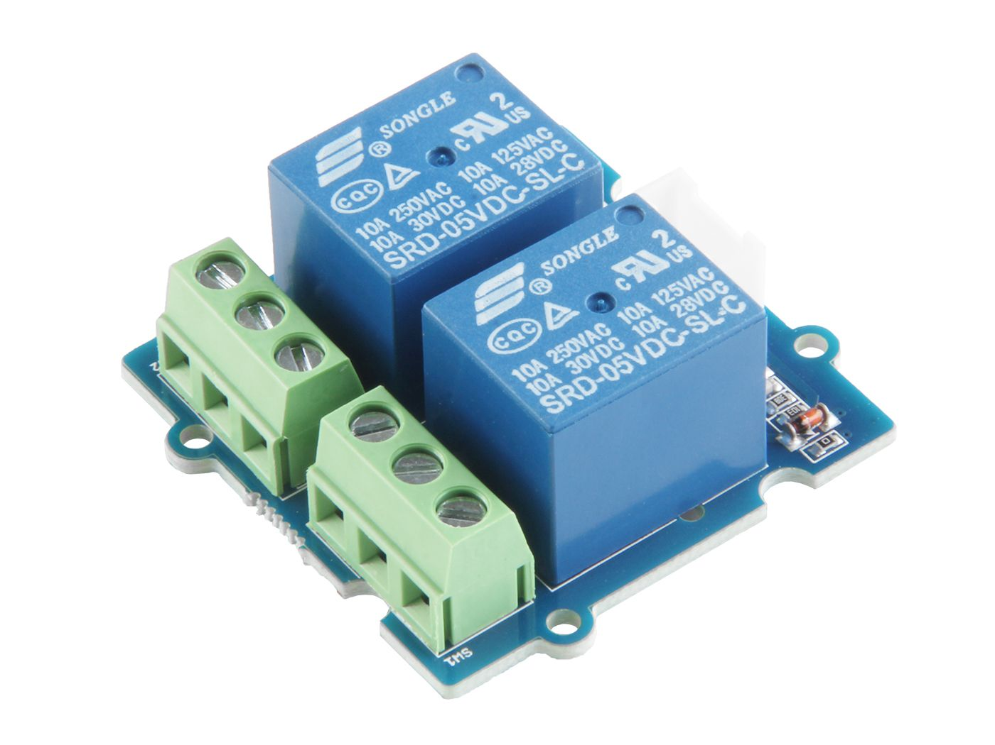
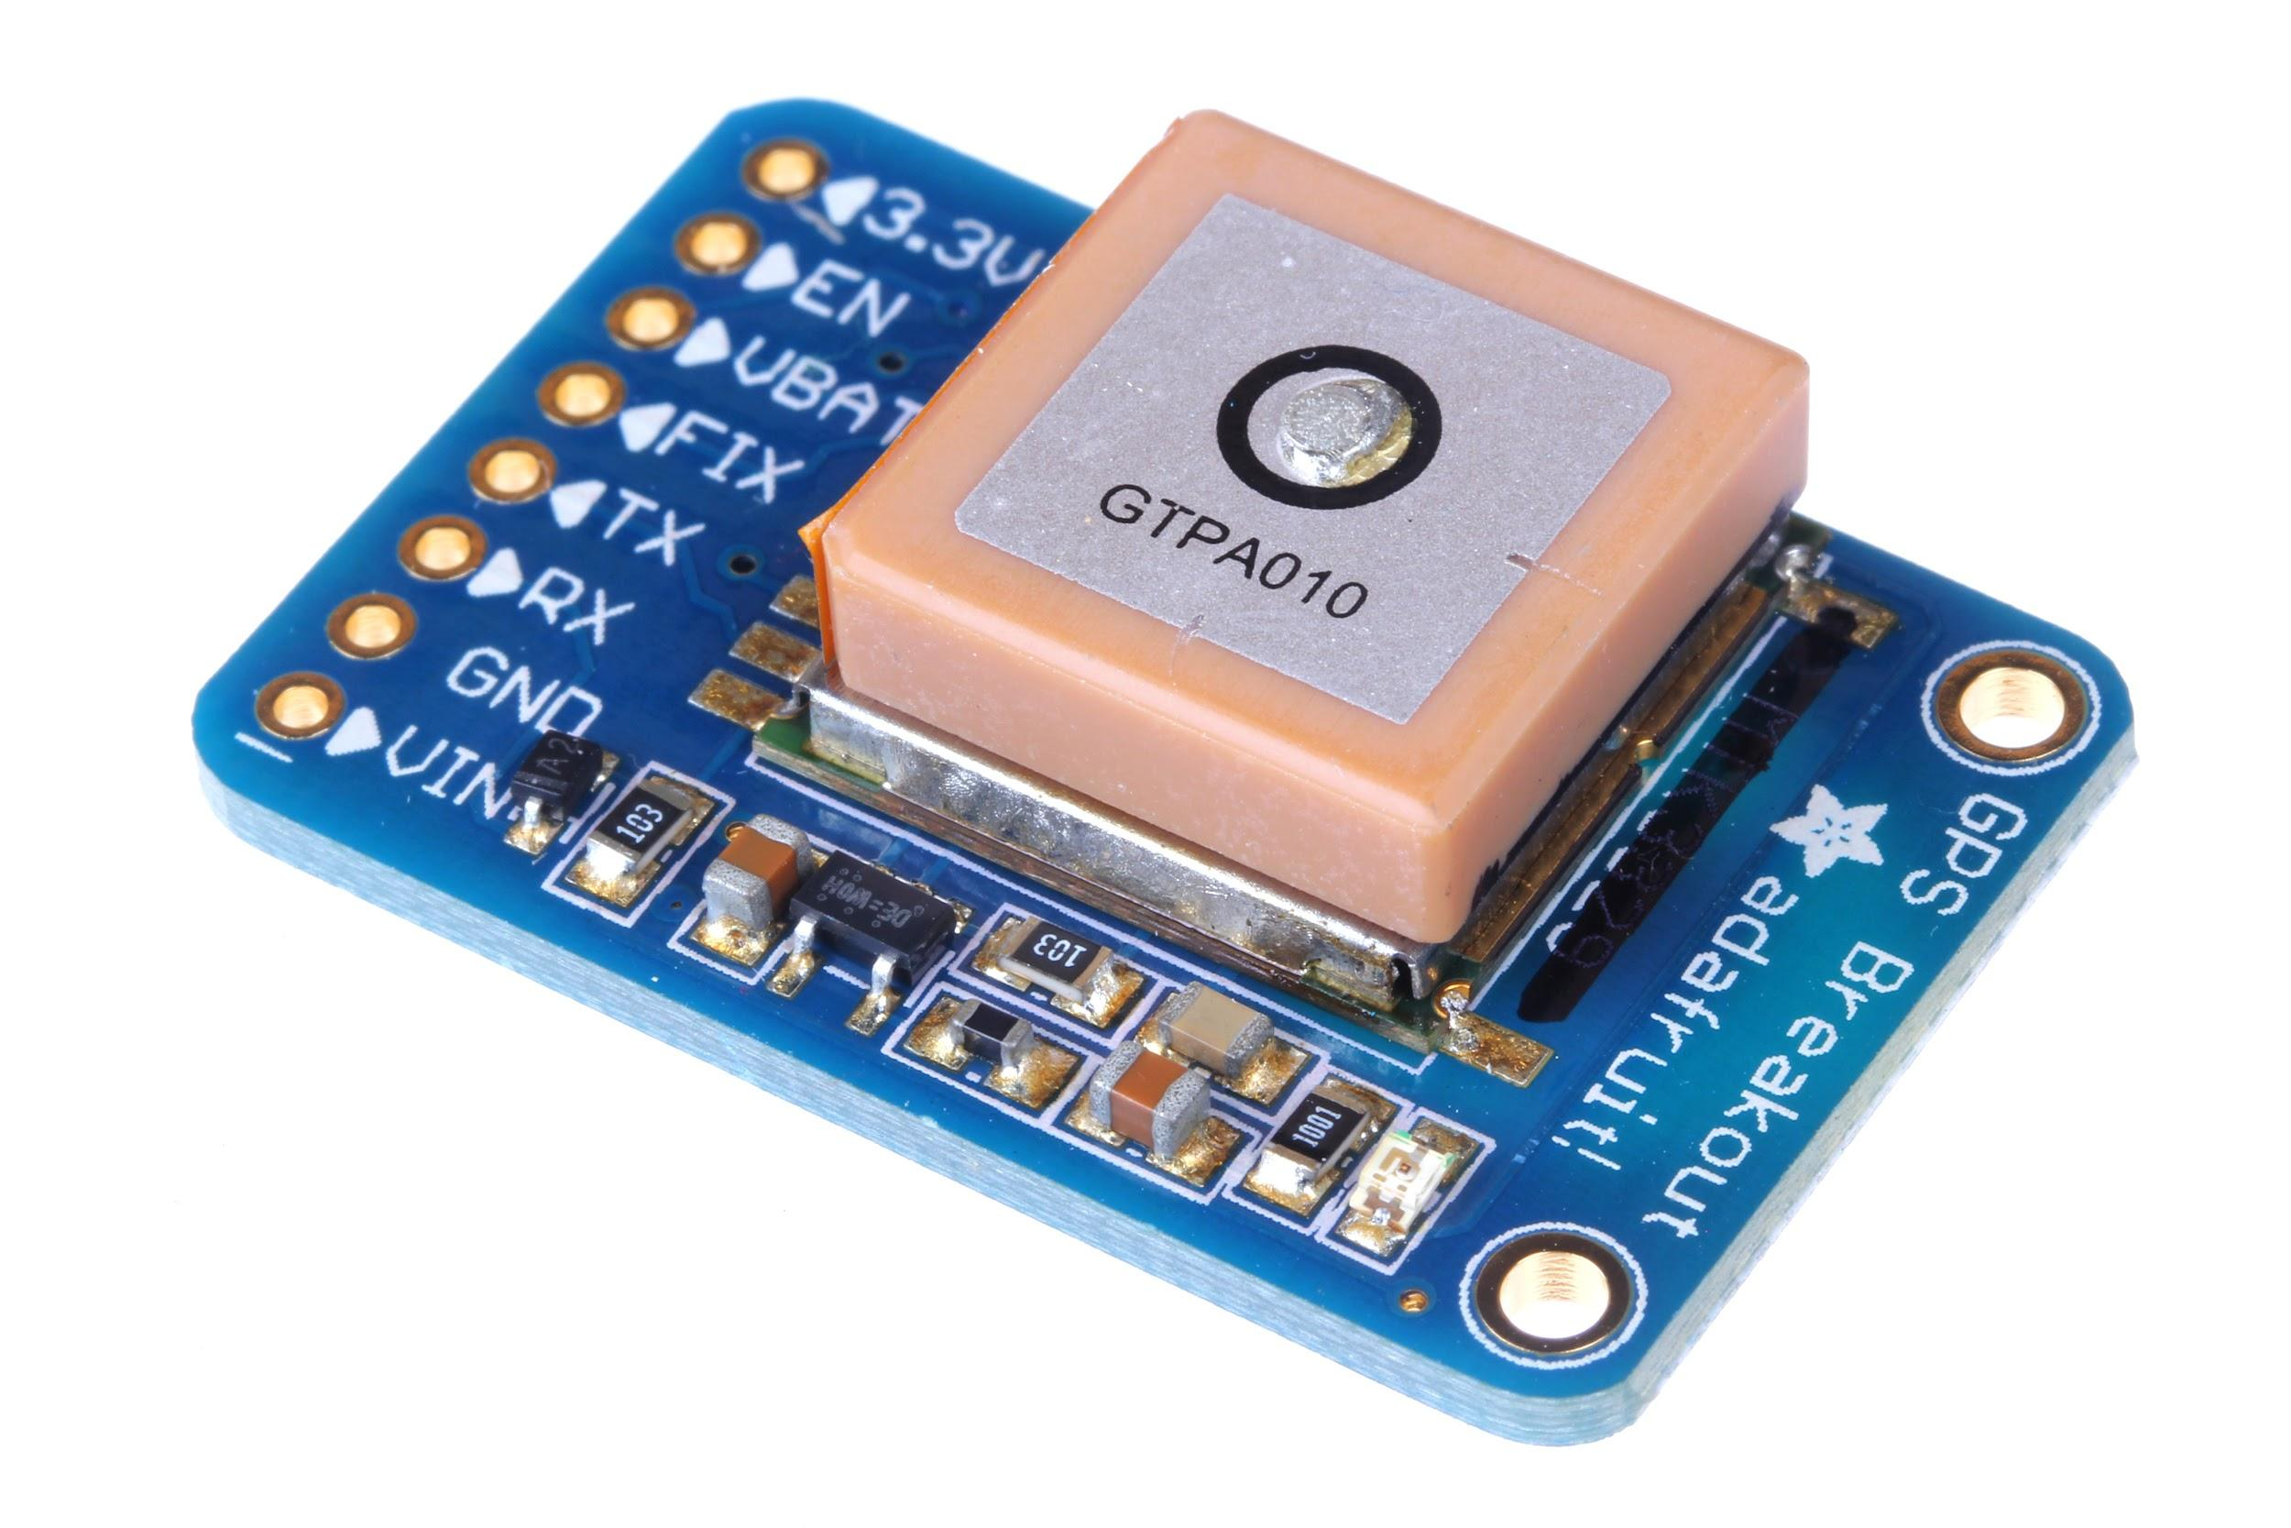
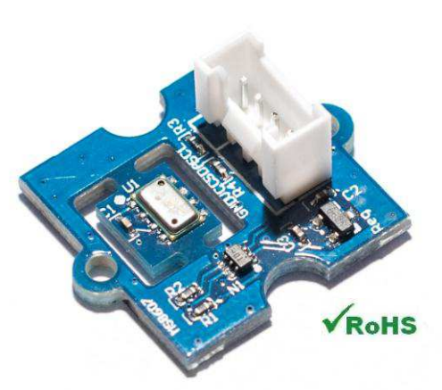
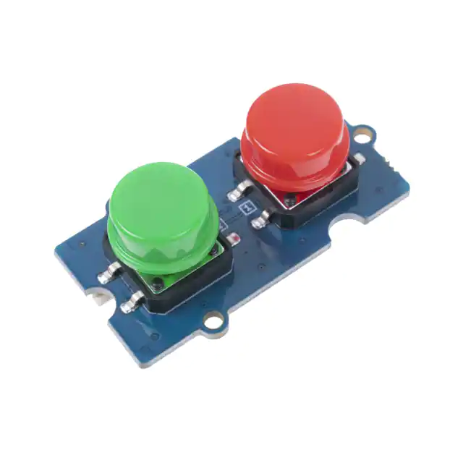
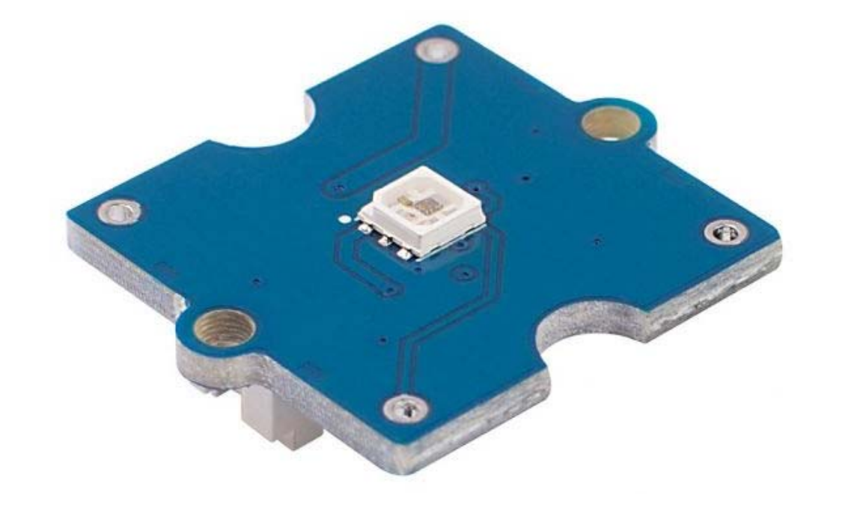
Potential Modular Accessory
Notes:
There is the potential for many kinds of modules that can extend the usability of the DAEmod platform.
We purchased popular modules to test with including OLED Display, GPS, Camera, LED, Buttons, and Environment Sensors.
With the choice of I/O Protocols, development with other sensors or interfaces like Doppler Radar or Relays is possible.

Slide 15
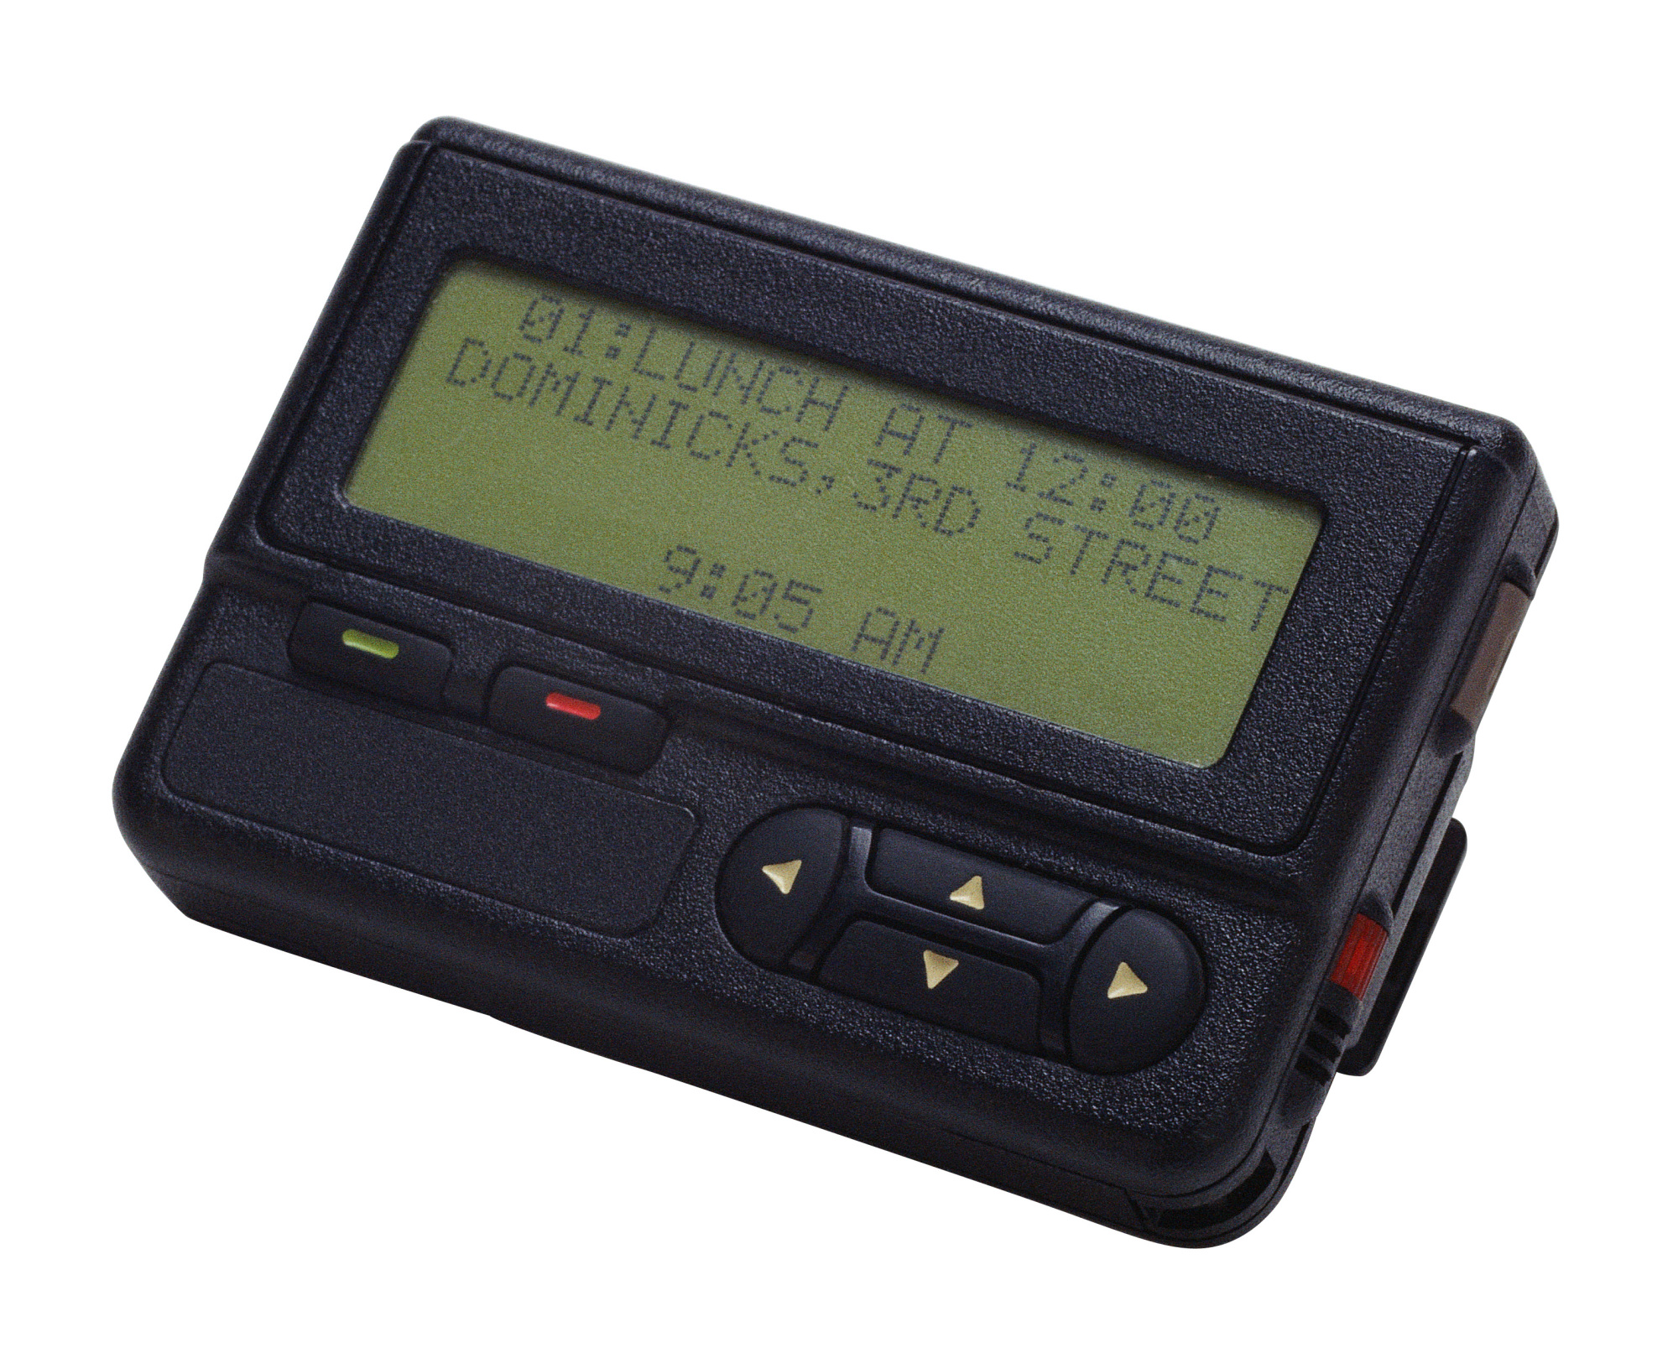
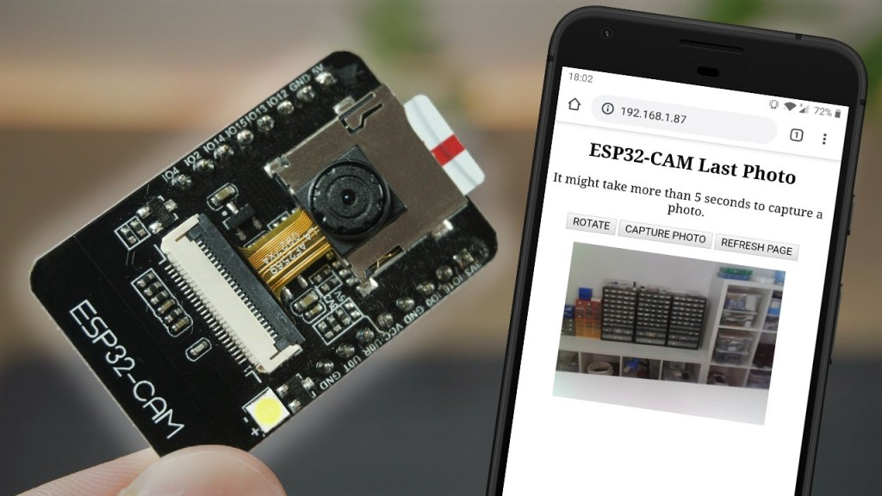
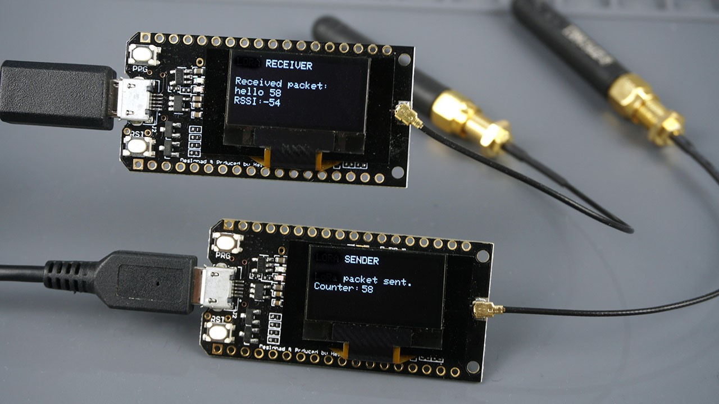
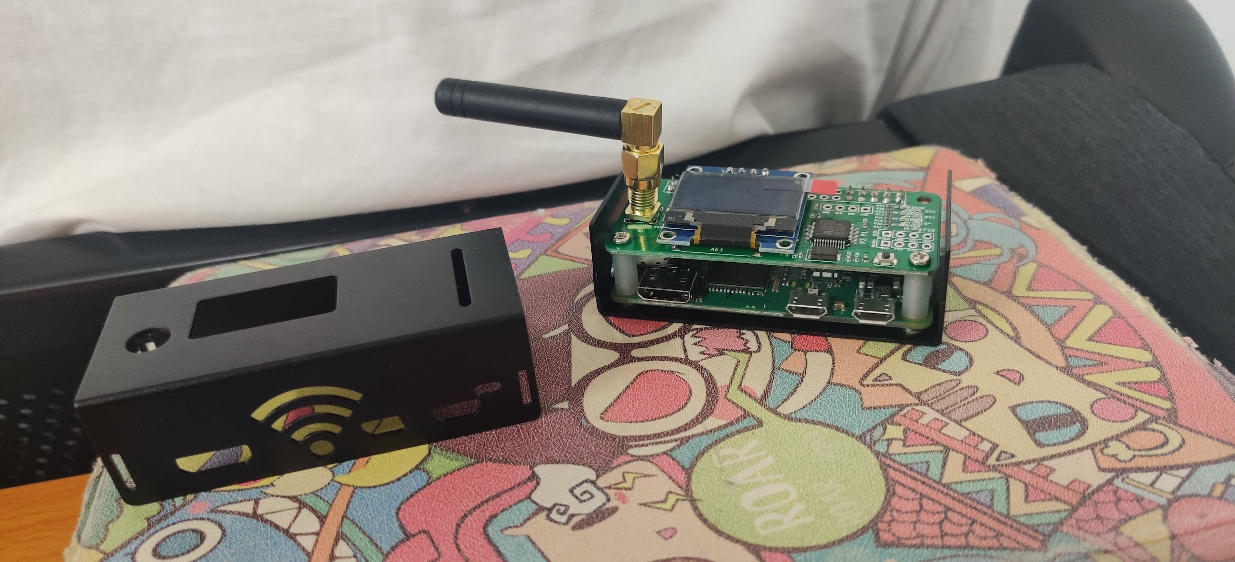
Potential Applications
Notes:
Potential applications of an open 915MHz transceiver for large data transmissions, like a remote trail cam, one-way transmissions, like a modernized pager system where email like messages can be broadcast. This could be the other way around for sensors that do not need to receive commands and instead regularly beacon information.
We are also inspired to make this for use in amateur radio, we are expecting this to taken into the amateur radio community so they can make use of the underutilized 33 cm amateur band. With a license, one can easily make use of increased power limits that would turn this into a high power, custom digital transceiver for any kind of project.

Slide 16
Timeline

Slide 17
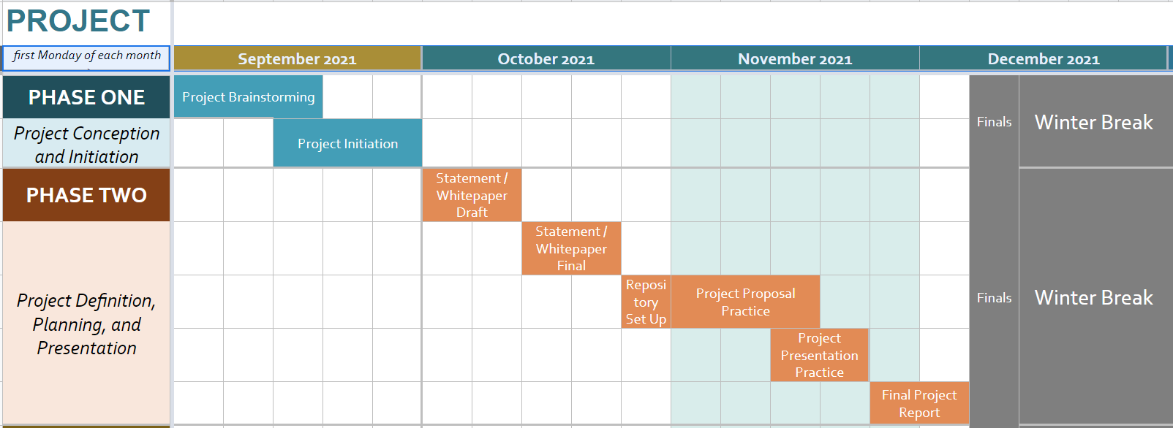
Fall Semester Schedule

Slide 18
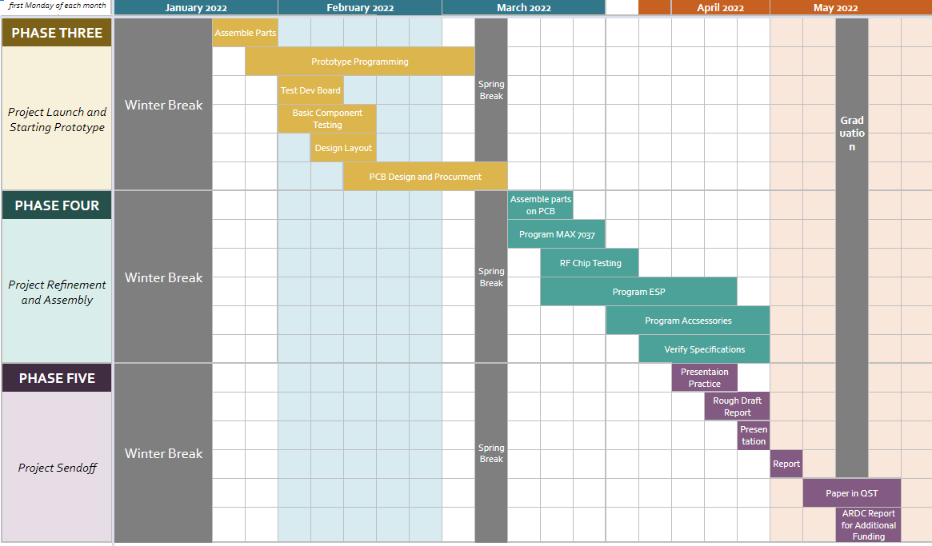
Original Spring Semester Schedule

Slide 19
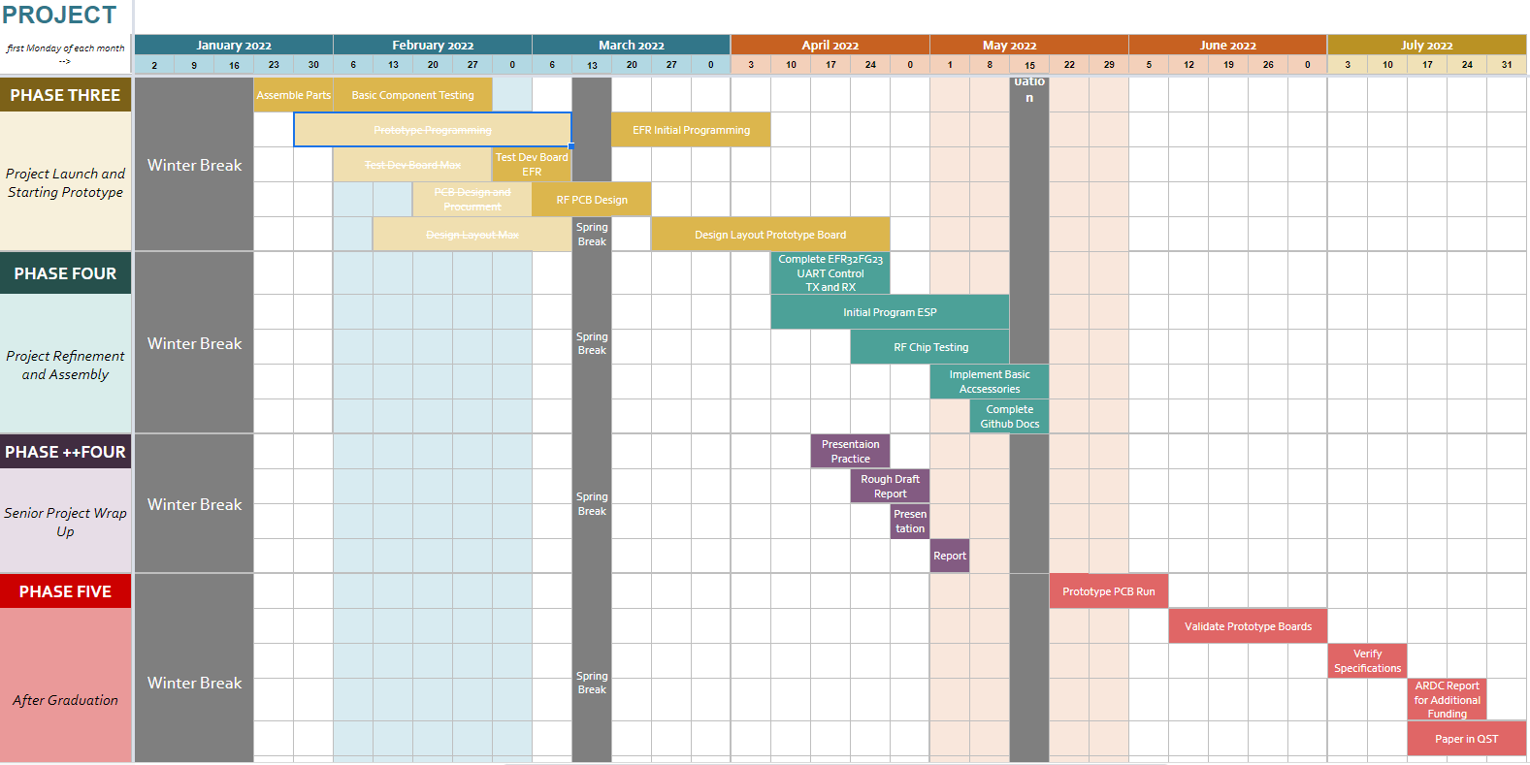
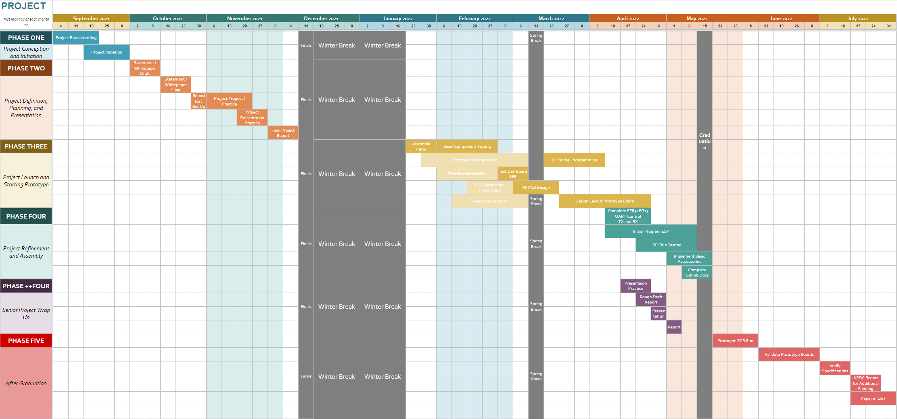
Current Spring Semester Schedule
Updated Schedule
Notes:
Delays and hardware changes pushed testing and design into April.
Added Phase 4++ and Pushed Phase Five till after graduation.
Supply chain limitation
Parts delays meant supplies did not arrive till after we left for winter break.
Parts out of stock or inflated pricing.

Slide 20
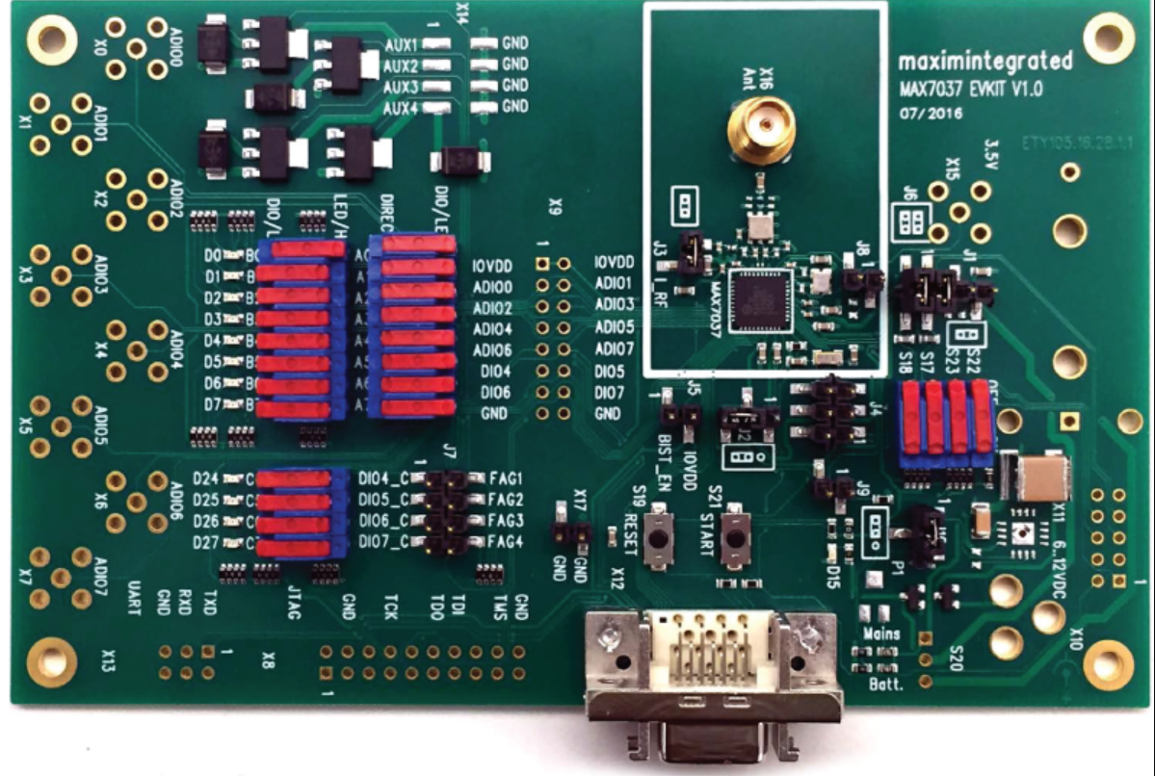
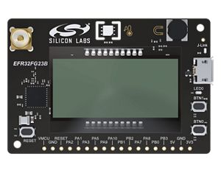
Part Discontinuation
Notes:
MAX
Maxim discontinued the MAX7037-Eval kit
Future discontinuation and end of life for the MAX 7037 expect to be announced soon.
Because of this a switch was necessitated to a new RF chip platform.
SI
Silicon Labs EFR32 series of chips was selected as a replacement for the MAX7037.
EFR32FG23A010F256GM40
Provided more support for RF encoding schemes, and is a new to the market.
Improved power efficiency

Slide 21
Initial B.O.M.
QTY | Vendor | Vendor Part | ITEM DESCRIPTION | UNIT PRICE | TOTAL
1 | Digikey | MAX7037EVKIT915#-ND | Eval Board Max7037 | $254.99 | $254.99
10 | Digikey | MAX7037EGL+-ND | MAX7037 Chips | $5.96 | $59.62
2 | Digikey | 343-ANT-916-CW-RCL-SMA-ND | SMA 900Mhz Hi Gain (Small) Antenna | $8.68 | $17.36
2 | Digikey | 2151-RST-W1B6-10808-22M-FY-001-ND | SMA 900Mhz Low Gain (Small) Antenna | $4.64 | $9.28
2 | Digikey | 1597-104020250-ND | OLED Display 1.12 (SH1107) v3.0 128x128 resolution | $12.50 | $25.00
1 | Digikey | 1597-103020272-ND | I2C HUB (6 PORT) | $1.70 | $1.70
1 | Digikey | 1597-1092-ND | 4PIN MALE JUMPERS 5PACK | $3.20 | $3.20
1 | Digikey | 1597-109020022-ND | GPS module for GPS / Beidou / Glonass / Galileo / QZSS / SBAS | $13.10 | $13.10
2 | Digikey | 1597-1674-ND | Switch Human Interface 5WAY | $4.90 | $9.80
2 | Digikey | 1597-104020169-ND | RGB LED | $4.40 | $8.80
2 | Digikey | 1597-111020103-ND | Switch Human Interface Large Dual Button | $2.40 | $4.80
1 | Digikey | 223-1785-ND | MS8607 SENSOR FOR GROVE SYSTEM | $16.09 | $16.09
2 | Digikey | 1597-1687-ND | ESP32-CAM 2MP WIFI+BT AI-THINKER | $10.00 | $20.00
2 | Digikey | 1965-ESP32-DEVKITC-32E-ND | ESP32-WROOM-32E series Transceiver Evaluation Board | $10.00 | $20.00
1 | Amazon | SMA Female Base | SMA Female Jack Connector 10-Count | $7.89 | $7.89
1 | Amazon | B07BBPX8B8 | UART Cable | $10.99 | $10.99
SUBTOTAL | $482.62
SHIPPING | $12.00
TOTAL | $494.62
Notes:
Bill of materials, the parts we will be using to develop our prototype and get started with the design, programming, testing under our starting budget

Slide 22
QTY | Vendor | Vendor Part Num. | ITEM DESCRIPTION | UNIT PRICE | TOTAL
10 | Mouser | 634-FG23-DK2600A | FG23-DK2600A Development Boards - Wireless FG23 | $39.00 | $390.00
20 | Mouser | 658-CR-2032/HSN | Coin Cell Battery 3V 220mAH | $0.93 | $18.56
5 | Digikey | 343-ANT-916-CW-RCL-SMA-ND | SMA 900Mhz Hi Gain (Small) Antenna | $8.68 | $43.40
5 | Digikey | 2151-RST-W1B6-10808-22M-FY-001-ND | SMA 900Mhz Low Gain (Small) Antenna | $4.64 | $23.20
2 | Digikey | 505-EVAL-CN0522-EBZ-ND | 900MHZ TX AMP TEMP SHUTDOWN | $41.25 | $82.50
2 | Digikey | 744-1442-ND | FILTER SAW 915MHZ INLINE | $36.72 | $73.44
20 | Digikey | 2057-PH1-18-UA-ND | CONN HEADER VERT 18POS 2.54MM | $0.25 | $4.96
1 | Digikey | PETG1752BLACK | IC3D PETG 1.75MM 2LB BLACK FILAM | $33.99 | $33.99
2 | Digikey | 1528-2185-ND | JUMPER WIRE M TO M VARIOUS | $4.95 | $9.90
1 | Digikey | 1528-1956-ND | JUMPER WIRE F TO F 8" 28AWG | $6.95 | $6.95
2 | Digikey | 1597-1085-ND | GROVE 4PIN CABLES 5PACK 5CM | $2.10 | $4.20
5 | Digikey | 1597-1082-ND | GROVE 2MM 4PIN VERT CONN 10PCS | $1.70 | $8.50
1 | Digikey | 3M9921-ND | RF EMI SHIELDING TAPE 18'X2" | $52.70 | $52.70
2 | Digikey | GSPB-103M-ND | BREADBOARD ASSEMBLY 9.06X6.89" | $43.73 | $87.46
2 | Digikey | 315-NC191SNL15-ND | SMOOTH FLOW LEAD-FREE SOLDER PAS | $12.95 | $25.90
1 | Digikey | SMD2SWLF.0158OZ-ND | LF SOLDER WIRE 99.3/0.7 TIN/COPP | $39.19 | $39.19
2 | Digikey | ACX2460-ND | CBL ASSY SMA RG174 19.69" | $16.91 | $33.82
2 | Digikey | ACX1636-ND | CBL ASSY SMA JACK-PLUG RG316 12" | $24.55 | $49.10
2 | Digikey | ACX1647-ND | CBL ASSY SMA JACK-PLUG RG58 6" | $22.25 | $44.50
8 | Digikey | 1597-104020250-ND | OLED Display 1.12 (SH1107) v3.0 128x128 resolution | $12.50 | $100.00
2 | Digikey | 1597-109020022-ND | GPS module for GPS / Beidou / Glonass / Galileo / QZSS / SBAS | $13.10 | $26.20
2 | Digikey | 3217-SDCIT2/8GB-ND | Memory Card microSD™ 8GB Class 10, UHS-I, U3, V30, A1 TLC | $12.00 | $24.00
10 | Digikey | LTC4162IUFD-FFS#PBF-ND | IC BAT LIFEPO4/LI-ION 1-9C 28QFN | $6.79 | $67.90
5 | Bioenno Power | BLF-0603W | 6V, 3Ah LFP Battery (PVC, BLF-0603W) | $24.99 | $124.95
1 | Powerwerx | WP15-10 | 15 Amp Red/Black Anderson Powerpole Connectors | $13.99 | $13.99
1 | Powerwerx | Wire-RB-12-25 | 25ft Red/Black Bonded Zip Cord Easy ID Low Voltage Cable | $24.09 | $24.09
1 | PCBWay |  | 10 Prototype Motherboards | $450.00 | $450.00
SHIPPING / HANDLING | $75.00
TOTAL | $1,938.40

Slide 23
System Modularity

Slide 24
Function testing Quantitative Testing
Component level testing
Software stability
Proper hardware installation
Digital Radio
Successful Tx/Rx modulation
Compliance with regulations
Module Testing
Operates as intended
Communication between systems
RF Power of Carrier
Carrier Frequency Deviation
Spurious emission of harmonics
Bandwidth of -20dbm
Notes:
Talk about how are you going to test, what is expected

Slide 25
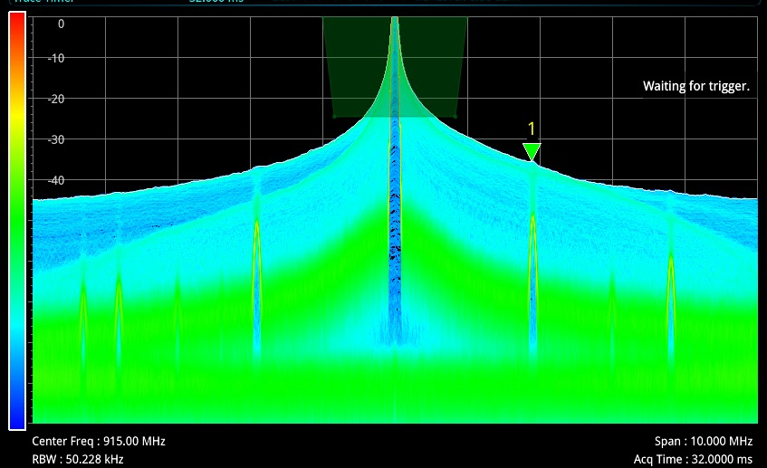
Results
Power of Carrier 6.716 dbm
Carrier at 914.988 Mhz (.0013% Deviation)
20dbm bandwidth .188 Mhz
6 harmonics more than 40dbm lower than carrier
Notes:
The testing for DAEmod happens in different batches for each part of the project. For EFR Hardware, we test for power draw in different power profiles, we also test for the power envelope of signal, signal to noise ratio, and the spurious emissions from transmit. For the ESP we test for the power draw and compatibility with the different speeds the EFR can read data. The functionality testing for the whole projects will have software stability testing and modular hardware and add software testing.
RF Lab
Network Analyzer
Spectrum Analyzer
Oscilloscope
Logic Analyzer

Slide 26
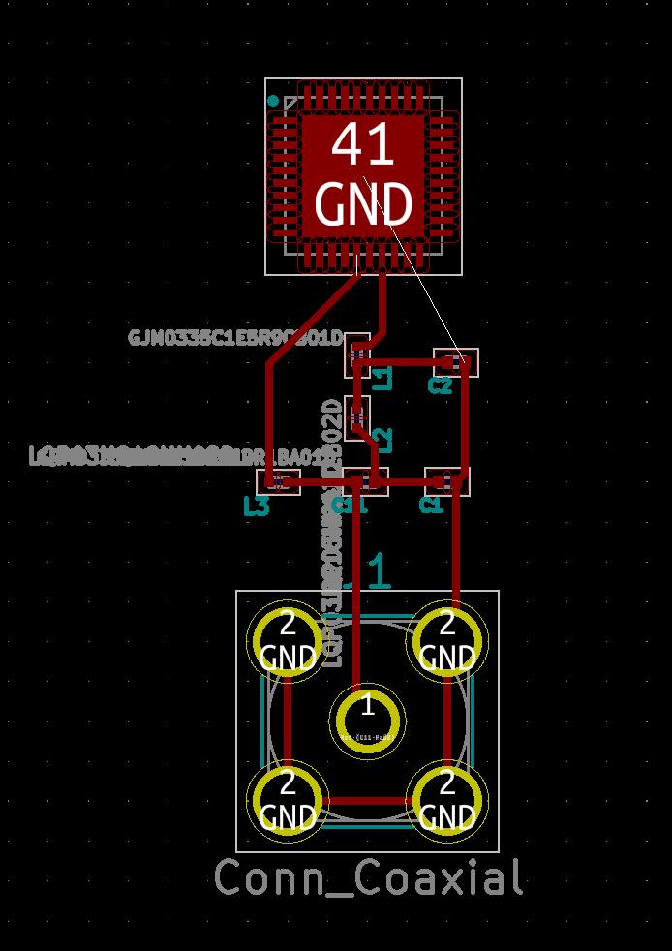
PCB
PCB Layers
Power
Signal
Signal
Ground plane
4 layer
Thickness 1.6mm
FR-4
TG 140-150
1oz copper
Notes:
PCB Designer / CAD
-Keysight PathWave ADS
-Altium
The prototype PCB design is at the beginning stages while we wait for parts from the first round grant from the ARDC. The prototype PCB will include mounting locations for the OLED screen, battery connector, GPIO pins, dev kit FG23, and ESP32 headers. This PCB is a interconnect and tinker board for the project. With room for intergraded modules and future hardware that will be designed for specific products and use cases.

Slide 27
Additional Considerations

Slide 28
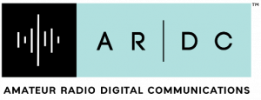
Funding
Three rounds of funding
ECE Department
ARDC R&D
ARDC Production
Notes:
The funding for the First bom was provided by the ECE department.
The second bom shown was funded by the Amateur radio digital communications foundation (ARDC). This funding is intended to continue R&D and allow for prototype boards to be producers.
Additional there is intended to be a third round of funding requested from the ARDC foundation to provide for a production run of development kits to be seeded to the community..

Slide 29


Project Near Future
Receive ARDC Funded Parts
Complete the proof-of-concept socketed prototype board
Publish in QST and spread awareness of completed prototypes
Notes:
Open Source allows for Endless Applications.
The Majority of our advances will be driven by community engagement.
With our current ARDC grant we are funded to do 2 prototype pcb runs, once those runs are completed we will be submitting a follow up grant request for the production run. These funds will also be used to create the DAEmod development kits which will be seeded to open source contributors to develop on hardware and for amateur radio operators to test the product in the field.

Slide 30


Project Long Future
Community Experimentation
PCB development creating the non-socketed board
Request ARDC Funding for Production Run
Notes:
Our github page is the location in which all the documentation for our own project lives, though the github we will be able to coordinate open source contributors and host the required resources to build and use the DAEmod boards.
Future development will continue with a few key areas, those being the pcb development, github and software development, and future funding. For the continued PCB development we will be creating the final prototype from the revisions and prototypes we will be producing. Once created, that PCB design will be used for the final small production run.
Open Source allows for Endless Applications.
The Majority of our advances will be driven by community engagement.

Slide 31
Conclusion
Notes:
Philip

Slide 32
In Summary
Adhere to open source software and hardware design philosophy allowing entire community to contribute.
Inexpensive hardware for experimentation and future development of DAEmod platform at a low cost.
Differentiate from LoRa via higher duty cycle and with extensibility in mind.
Provide plenty of opportunities for educational development and learning experiences in digital communications technology.
Notes:
In Summary,
Our project was to design DAEMOD with the OS-OH philosophy in mind.
We differentiated ourselves from LORA by making our platform for higher duty cycle applications, and using inexpensive hardware to make development cost low. By this we Provide plenty of opportunities for educational development and learning experiences in digital communications.
With that Questions?

Slide 33
Any Questions?
Notes:
Developing a 915MHz open-source and open-hardware system for digital radio experimentation in the underutilized 915 MHz ISM band allocation. The main features of the project include a configurable duty cycle and support for multiple FSK/ASK modes. As a result, it is configurable to specific use cases like a remote trail camera or a modernized pager system. We chose low-cost and ubiquitous hardware (ESP32, I2C sensors, EFR32FG23, ...) to build a sustainable platform and showcase the potential use cases of a finalized product. Overall, our design focuses on extensible and easy communication where traditional infrastructure is not suitable.

Slide 34
References
https://www.espressif.com/sites/default/files/documentation/esp32_datasheet_en.pdf
https://docs.espressif.com/projects/esp-idf/en/latest/esp32/
https://datasheets.maximintegrated.com/en/ds/MAX7037.pdf
https://lora-alliance.org/resource_hub/lorawan-104-specification-package/
https://www.silabs.com/wireless
https://github.com/SiliconLabs/application_examples
https://docs.platformio.org/en/latest/what-is-platformio.html
https://www.ampr.org

